Slide 1
ANOVA
Analysis of Variance

Slide 2
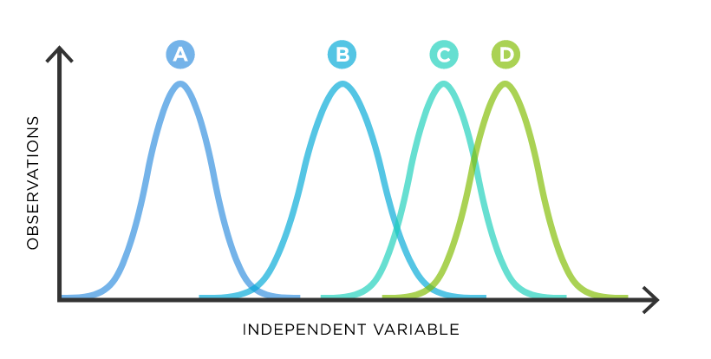
ANOVA Basics
Similar to Z / T testing, but with multiple groups simultaneously
One or more “factors” / categorical variables (school type, major)
Each factor contains two or more levels (public/private, engineering/biology/economics…)
(Levels can be numerical ranges or categories)

Slide 3

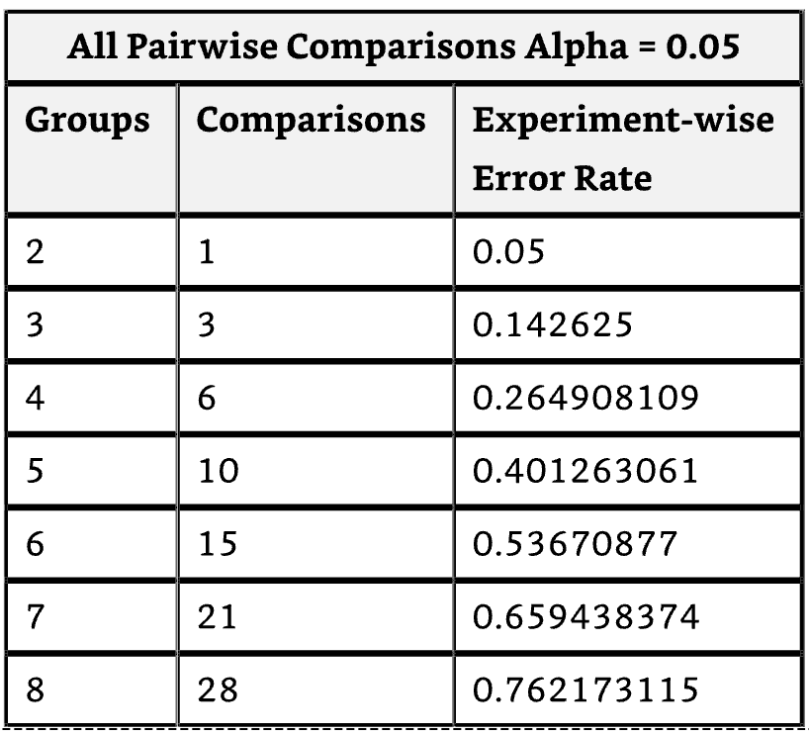
Why not lots of T tests?
If each t-test has an alpha of 0.05%, 1 in 20 will be significant by chance. ANOVA can test all 20 at once and still only have a 0.05% chance of a type one error
ANOVA takes into account variance across all groups

Slide 4
One Way ANOVA
Used to detect significant differences among means values of three or more samples / groups / factors
Assumptions:
Population / test statistic is normally distributed (CLT covers this)*
Populations have equal variances (Welch’s ANOVA otherwise)*
Appropriate sampling (unbiased, independent)
*If these assumptions are not met, ANOVA is still probably still fine if n >30

Slide 5
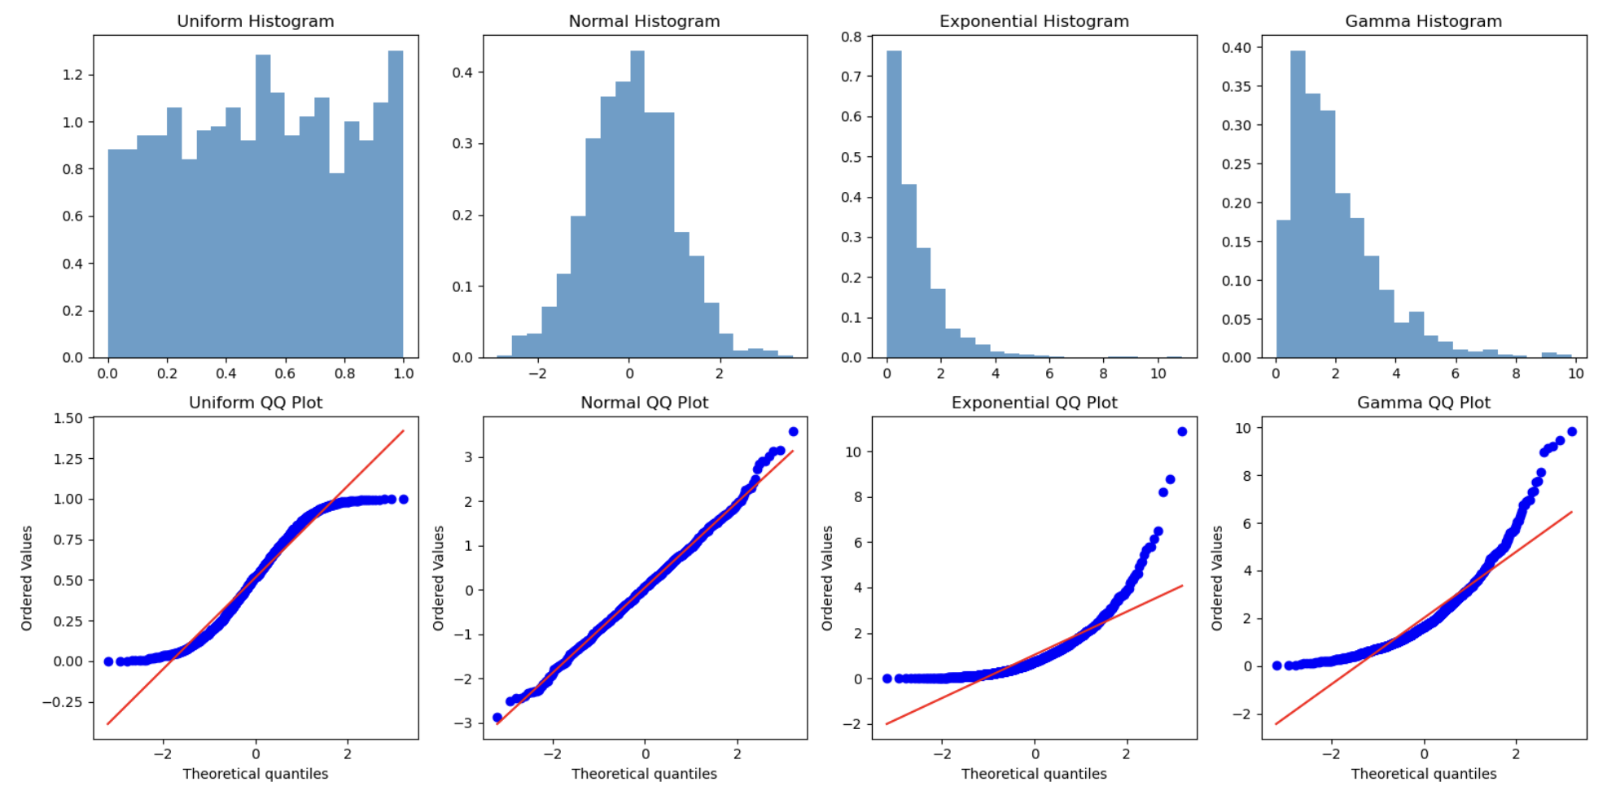
Q-Q Plot and Histogram For Normality (Again)

Slide 6
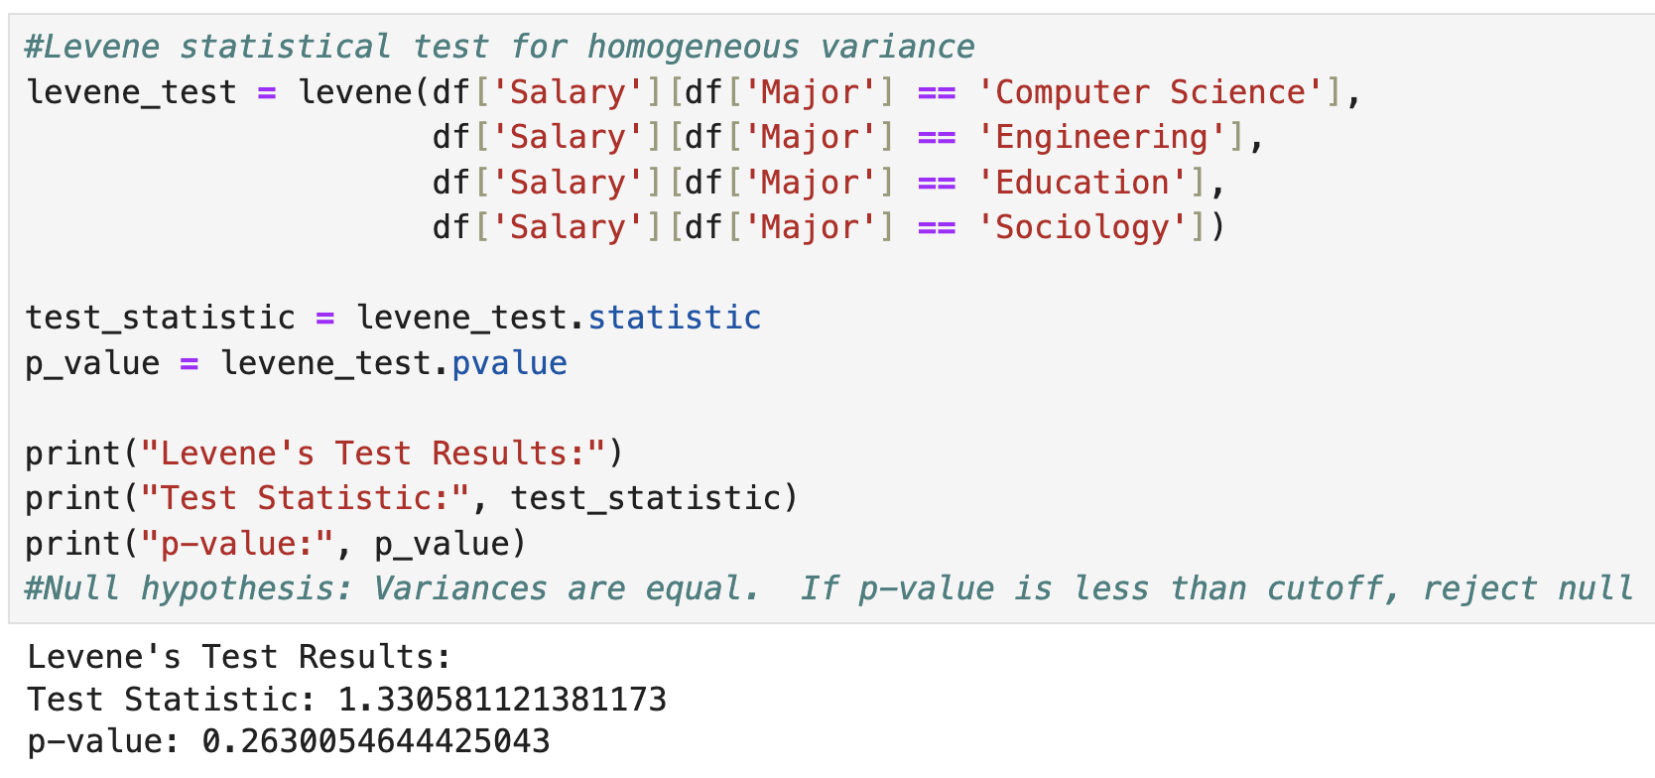
Lavine Test For Equal Variance
P value < alpha = reject null of equal variance

Slide 7
One Way ANOVA
H0: Group 1 Mean = Group 2 Mean = Group 3 Mean
HA: At least one of the group means is different to a statistically significant extent from the others

Slide 8
Variation
Total Variation (SST) = Within Group Variation (SSW) + Among Group Variation (SSA)
Sum Of Squared Variation Within Groups (SSW)
Calculate the mean of each group
Calculate differences between each observation and its group’s mean
Square the differences
Add up all the squared differences = SSW
Sum Of Squared Variation Among Groups (SSA)
Calculate the mean for all observations (grand mean)
Calculate the mean for each group
Calculate the differences between each group’s mean and the grand mean
Square the differences
Multiply each group’s squared difference by the number of observations in each group to weight the values
Add up all the multiplied squared differences = SSA

Slide 9
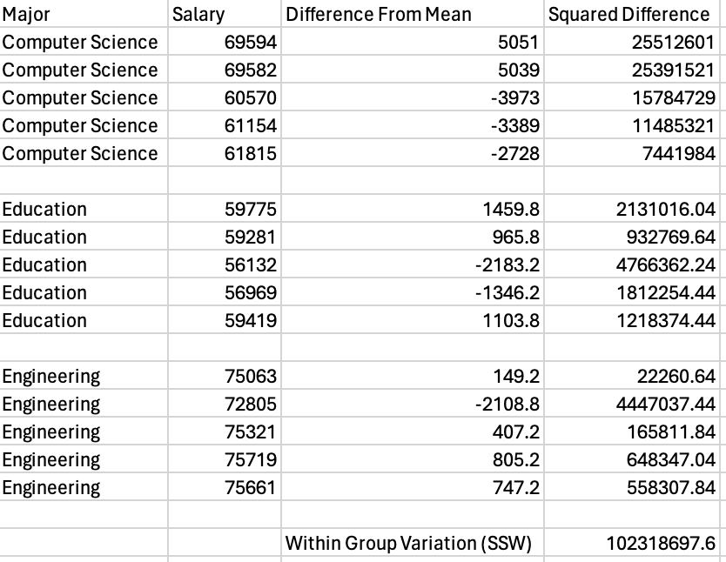
Example SSW
Calculate mean of each group
Calculate each observations difference from it’s group mean
Square the differences
Sum them up!

Slide 10
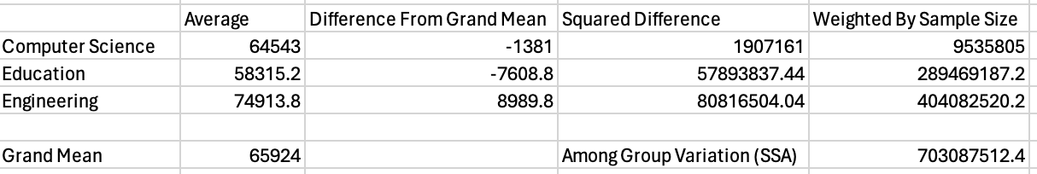
Example SSA
Calculate group averages and overall average (grand mean)
Subtract grand mean from each group average
Square the differences
Weight by sample size
Sum them up!

Slide 11
Mean Squares and the F Statistic
Mean Square Among (MSA) = SSA / (c - 1), where c is the number of categories. (In our example, c =3)
Mean Square Within (MSW) = SSW / (n - c), where n is the total sample size from all groups and c is the number of categories. (In our example, n=15)
F Statistic = MSA / MSW

Slide 12
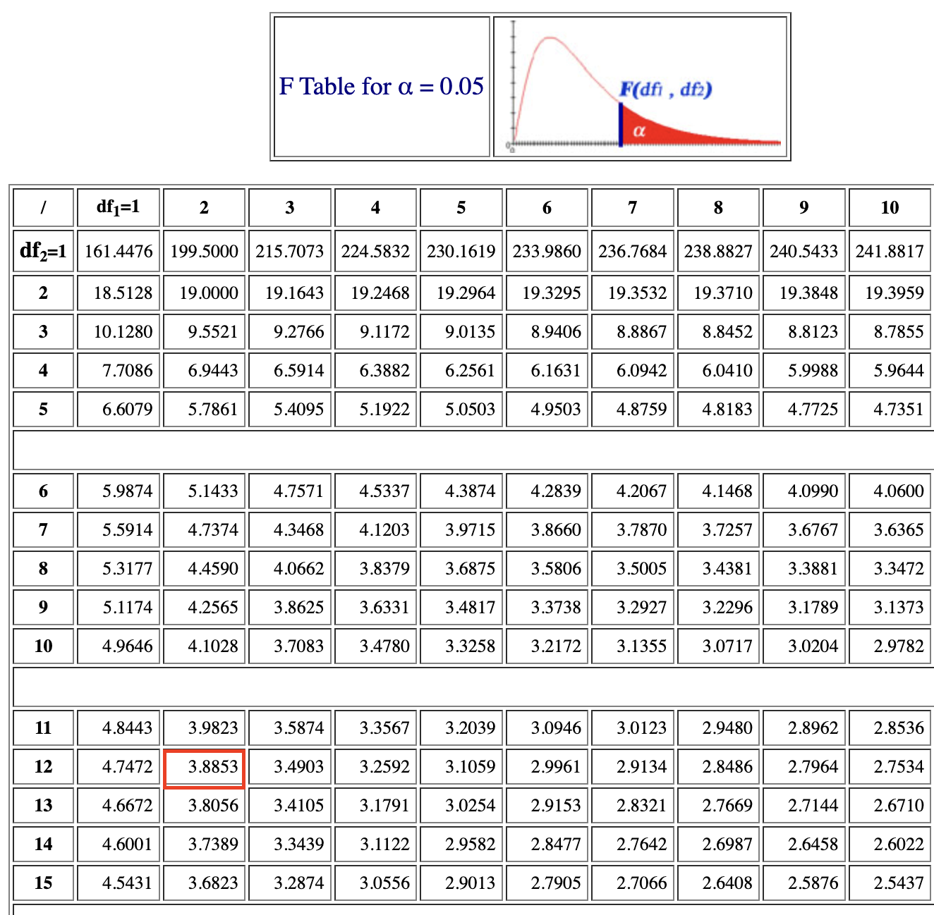
F Statistic vs F Critical Value
Select a level of confidence
c = number of categories
Consult an F table for that level of confidence where df1 = c - 1 and df2 = n - c
α
0
Do not
reject H₀
Reject H₀
F_{α}

Slide 13
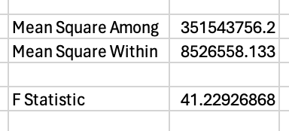
Example F-Statistic and Critical Value
Mean Square Among (MSA) = SSA / (c - 1), where c is the number of categories
Mean Square Within (MSW) = SSW / (n - c), where n is the total sample size from all groups and c is the number of categories
F Statistic = MSA / MSW
Consult an F table for that level of confidence where df1 = c - 1 and df2 = n - c
Since F > CV, reject the null hypothesis that all group means are equal.

Slide 14
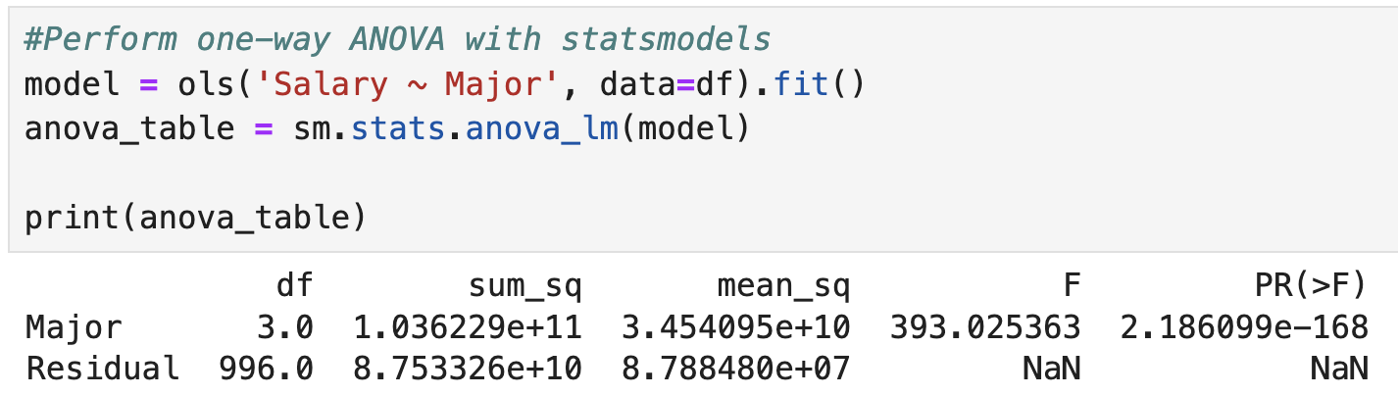
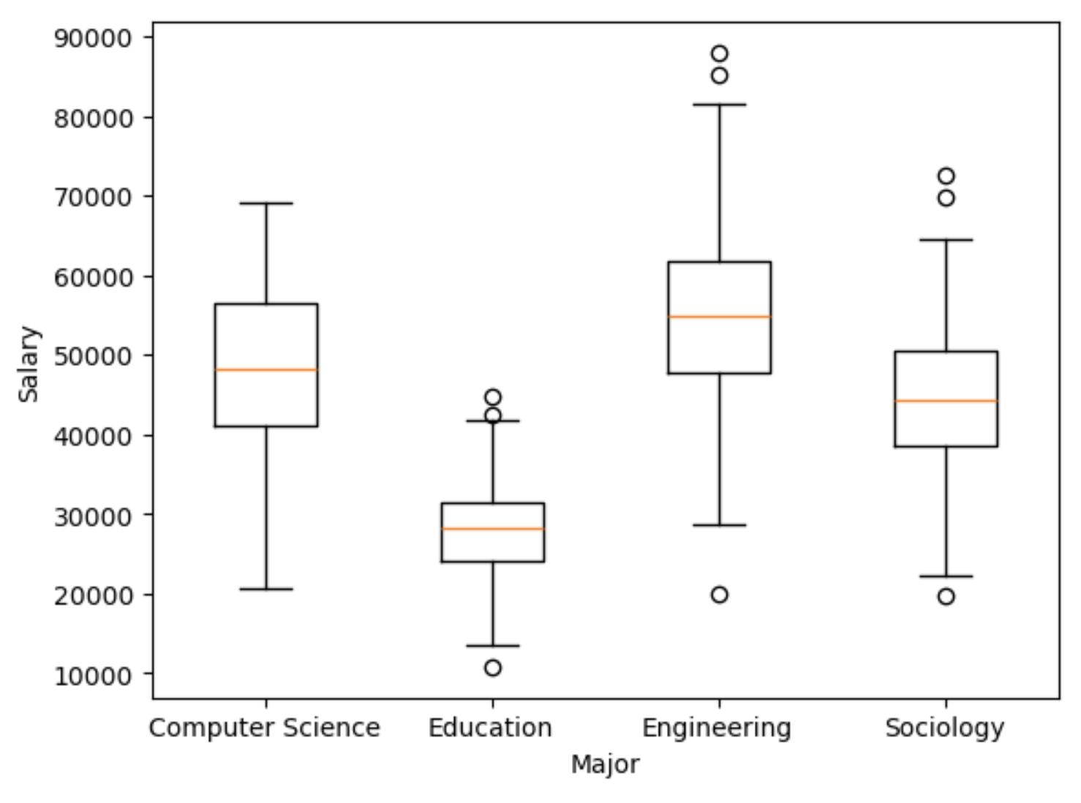
If p<alpha, reject null of equal means

Slide 15
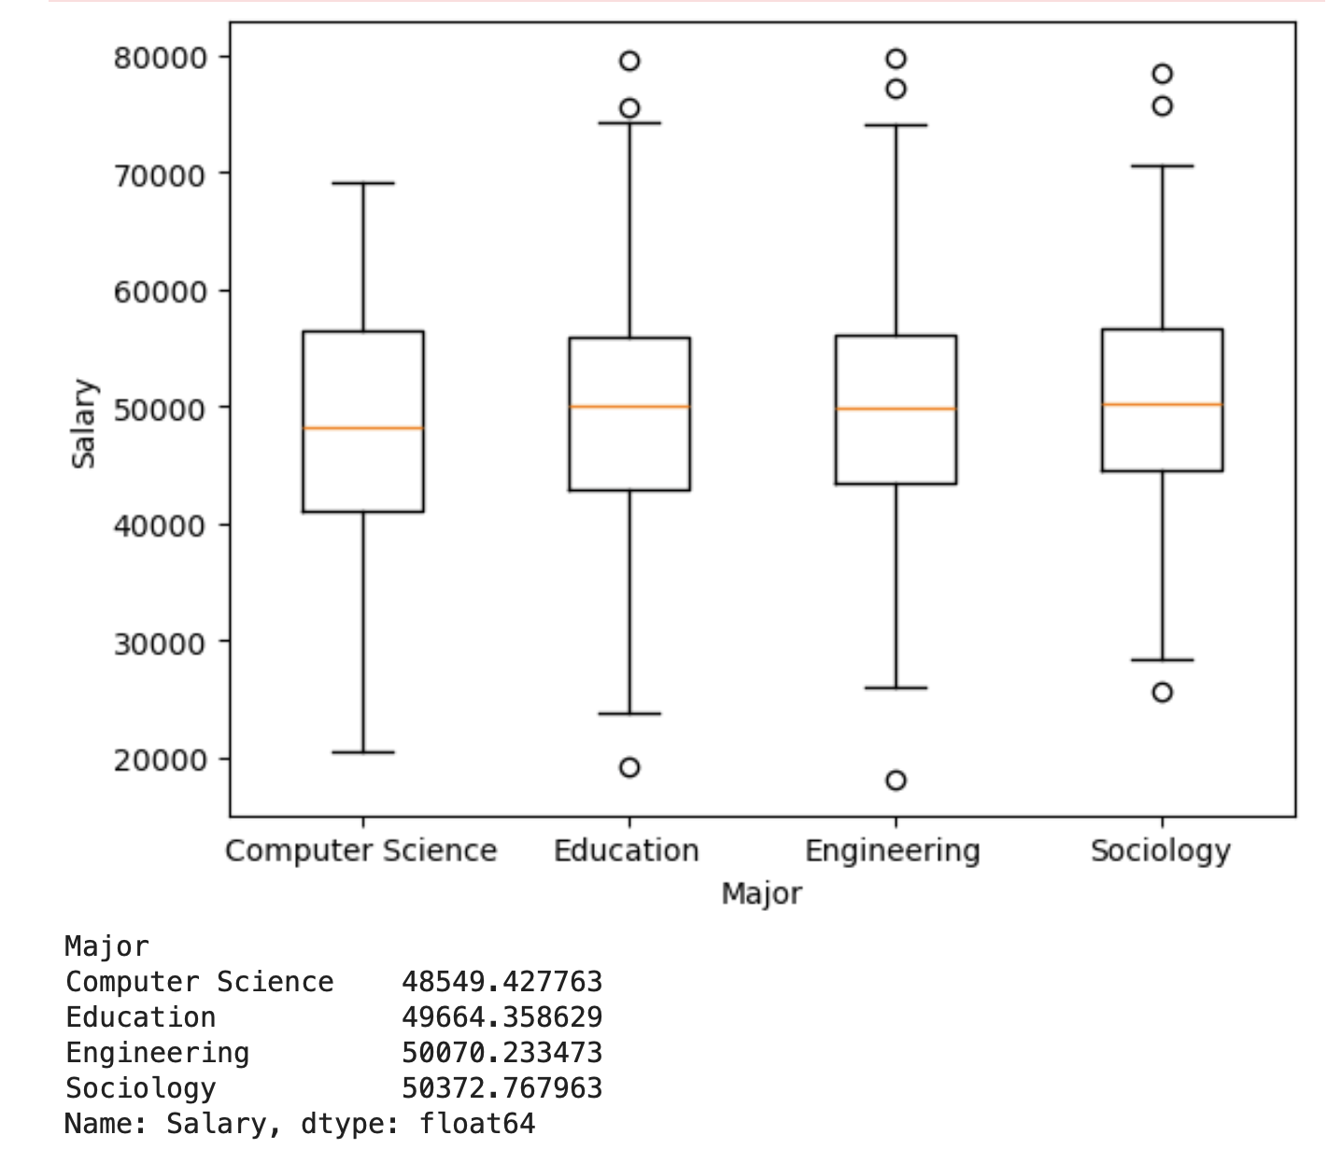
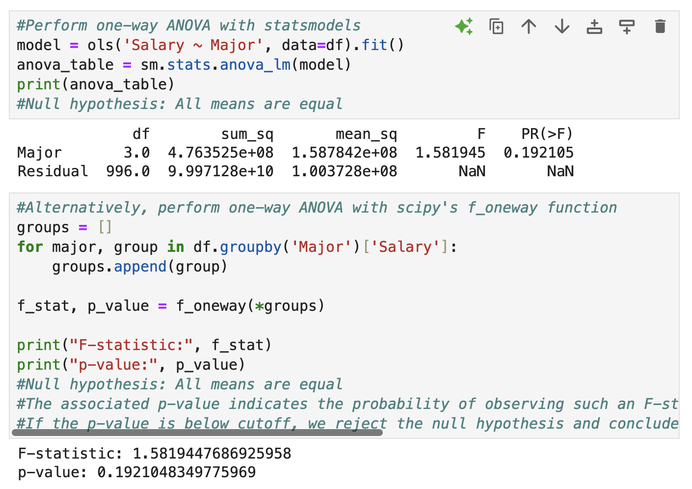
Fail to reject null since p > alpha

Slide 16
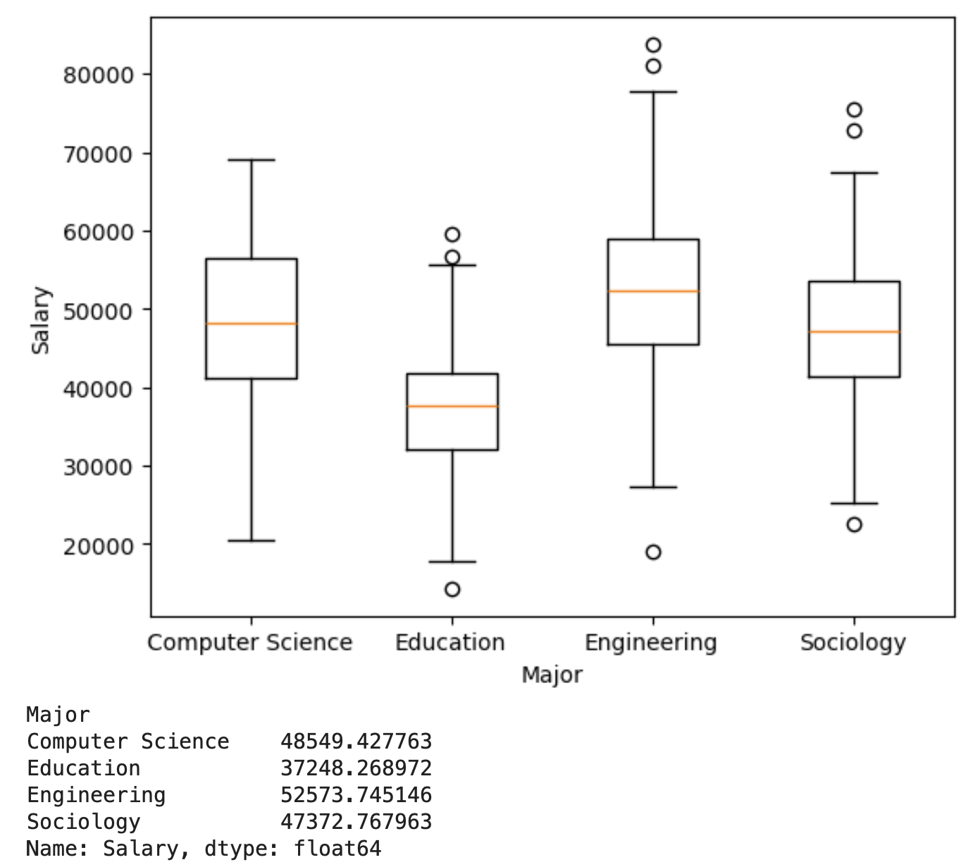
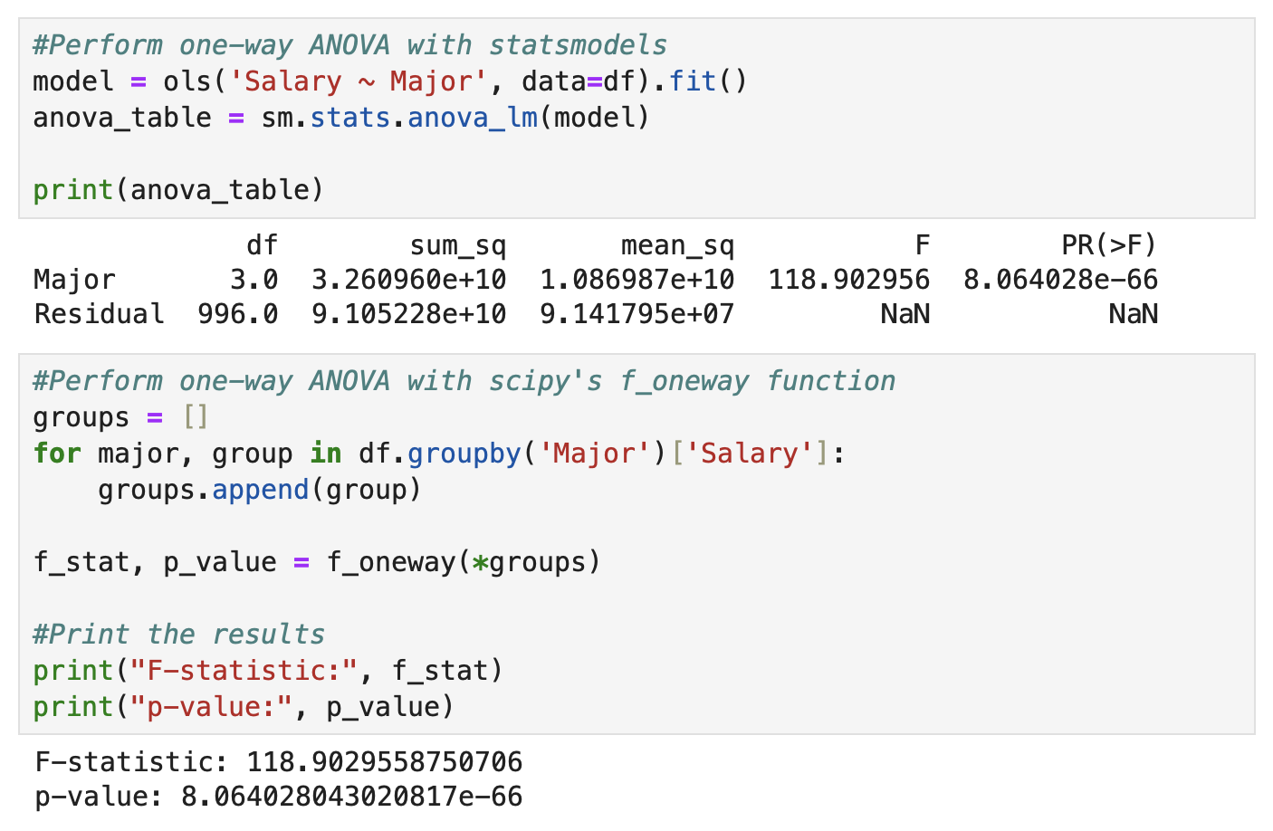
Reject the null since p < alpha

Slide 17
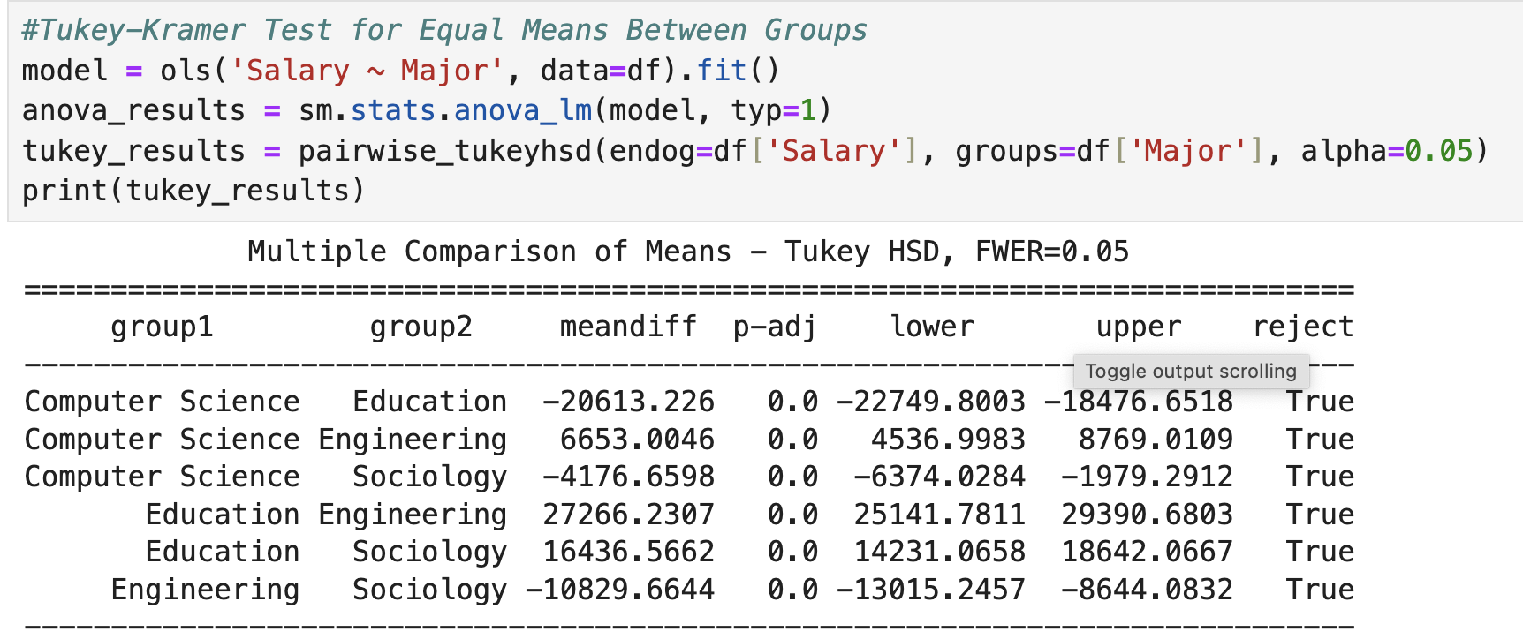
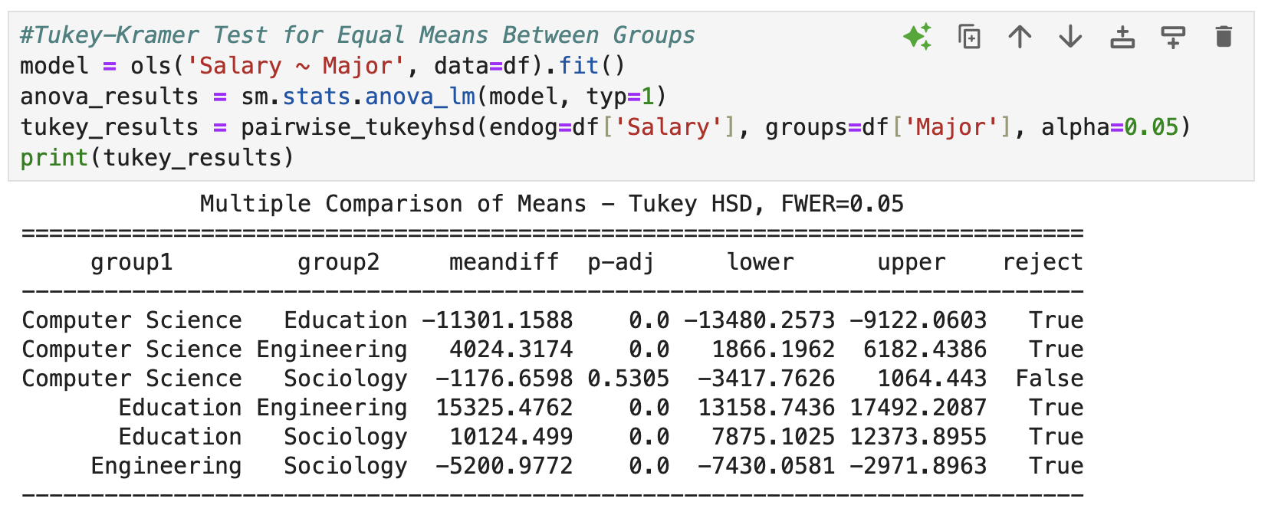
Tukey-Kramer
All differences are significant
Difference between CS and Sociology is insignificant
Tests each pairwise difference without inflating risk of type one error (as would be the case with six pairwise t-tests)

Slide 18
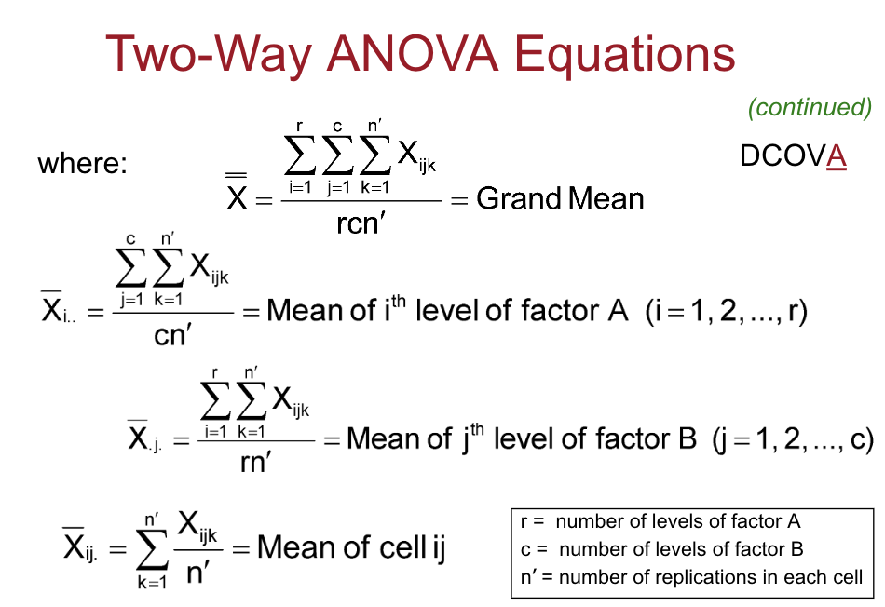
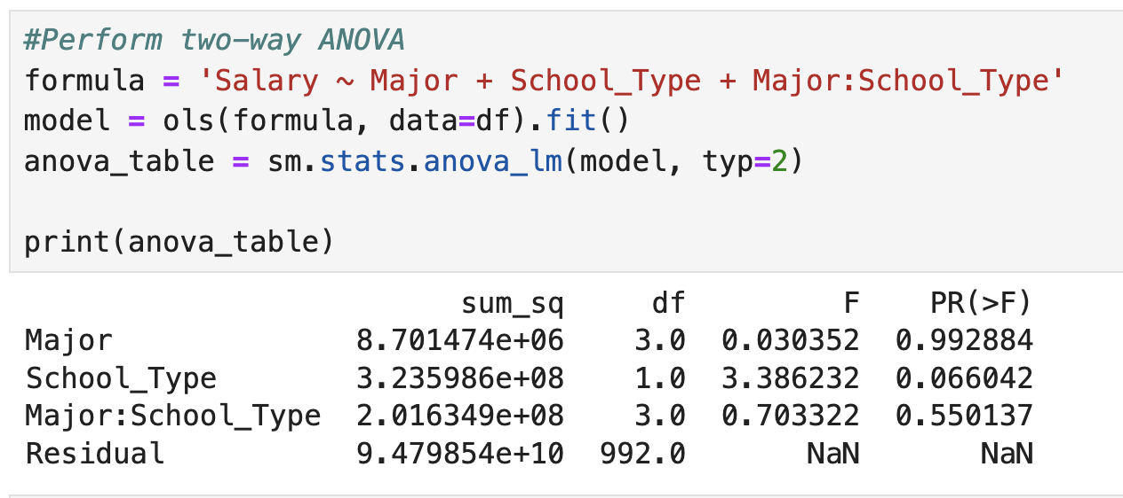
Two Way ANOVA
Used when there are two factors
Math gets a lot more tedious
Can also test for interaction effects between factors
Example interaction: Does choice of major affect salaries differently for private school students than it does for public school students

Slide 19
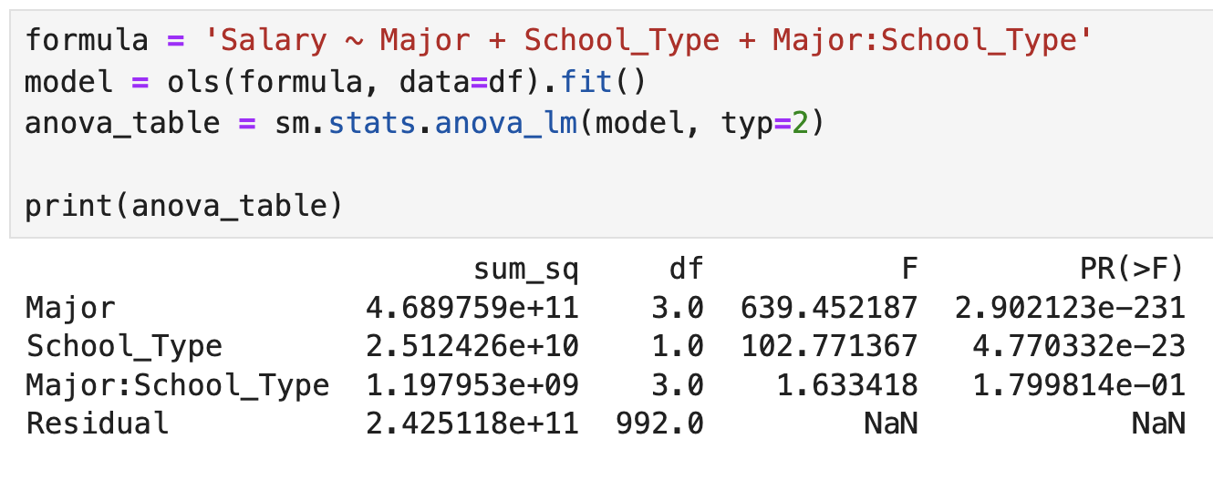
Insignificant differences
Significant differences for major and school type, not for interaction

